Slide 1

FindYourHome
-GET YOUR DREAM HOME
Madhu Gage – 20104037
Amir Madoo-20104013
Manashree Chavan-20104028
Darpan Mhatre-20104019
Project Guide
Prof. Vishal Badgujar

Slide 2
Contents
Introduction
Objectives
Scope
Features / Functionality
Project Outcomes
Technology Stack
Block Diagram

Slide 3

1. Introduction
Problem Identified :
    Expensive
    Third party
    Time consuming
Solution Proposed :
  User to user interaction
  Easy listing

Slide 4

2. Objectives
To create an environment with good user experience for both the consumer and seller.
To have clients better visibility.
To have better marketing.

Slide 5

3. Scope
Can be used by broad range of users.
Can be used to increase efficiency.
Can be used to save time.
Can be used to find Residential and commercial property.

Slide 6
4. Feature /Functionality
Listing:
    Users can list property on our software for selling , renting
    Or for commercial purpose
Rent:
    User can rent any property of their choice with various option available for finding the property of their choice
Commercial:
    User can use their land to generate property by using commercial feature for business purpose

Slide 7

5. Outcome of Project
User can Log in or Register
User can sell, buy, rent, commercial property
Users can use several filters to find the property of their dreams, such as
  Location
  Size
  Price

Slide 8


6. Technology Stack
Programming language: Python
Operating System: Windows 11
Development Environment: Visual studio
Database: SQLlite3

Slide 9
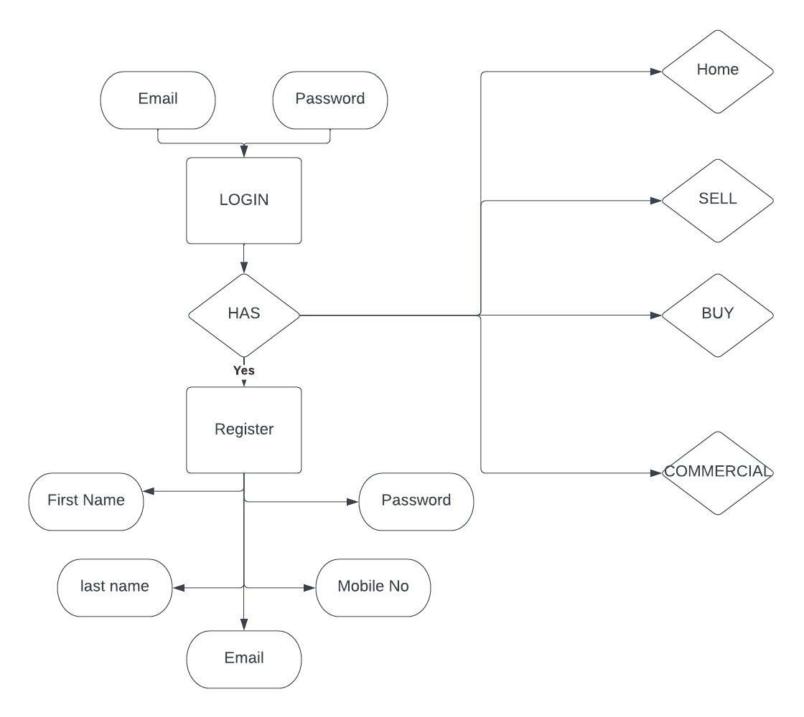
Block Diagram

Slide 10
Thank You...!!

